Slide 1

Suffolk Coastal Poverty Action
January, 2026
Suffolk Coastal Poverty Action
Churches working in partnership in East Suffolk

Slide 2
1. Background and Context
The Suffolk Coastal Debt Centre was founded in 2018 as a debt help organisation
In the intervening 7+ years, other services have progressively been added
In 2025, we changed our name to Suffolk Coastal Poverty Action to reflect this wider mission
The organisation is legally part of SKC Church in Saxmundham
However, we partner with around 20 churches in East Suffolk of all denominations
2018 to 2025
Suffolk Coastal Debt Centre:
A Debt Help organization
with a range of
collateral activities
Suffolk Coastal Poverty Action
Churches working in partnership in East Suffolk

Slide 3
2. Our work
SCPA offers a range of services, including:
Debt Help – working with those with unmanageable debts to become debt-free
Money Coaching – training people to manage their money and budget to avoid getting into trouble financially
Life Skills – working with people to give them vital life skills (budgeting, cooking, shopping wisely, mental health tips etc.)
Debt Centre Relief Fund – channelling emergency financial support to existing service users
Debt First Responders “DFR” – a triage service to provide immediate support to all experiencing poverty
Counselling – we partner with and pay for professional counselling where our service users cannot access our services due to their mental ill health
Money guidance in Prisons
Money Coaching in Schools – financial education in Primary & Secondary schools
Suffolk Coastal Poverty Action
Churches working in partnership in East Suffolk

Slide 4
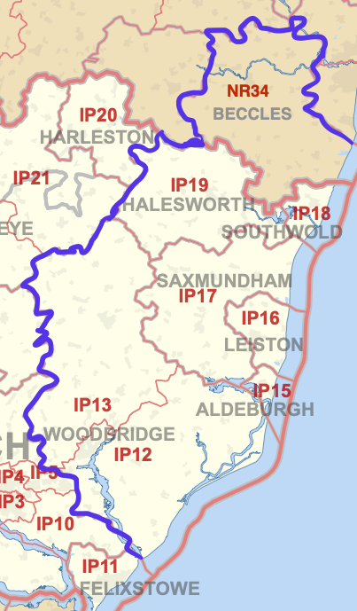
3. Our coverage area
Our current catchment area is shown in purple.
East Suffolk has few large towns but there are a number of small market towns including: Woodbridge, Aldeburgh, Leiston, Saxmundham, Framlingham, Halesworth, Beccles and Southwold
In addition, there are literally dozens of villages and hamlets where amenities are few and public transport is virtually non-existent
Suffolk Coastal Poverty Action
Churches working in partnership in East Suffolk

Slide 5
4. Poverty in East Suffolk
Over time, the circumstances and experience of our service users have changed:
2018-19
Debt mainly arising from relationship breakdown; limited wider issues.
2020-21
Government pandemic support largely hid debt issues
2022-today
Cost of living crisis & impaired mental health leading to multi-factor poverty
Mostly DMPs, some DROs.
Limited demand or capacity.
Few DMPs, some DROs, a lot of broken budgets
Debt is a symptom of poverty; we now need to focus on its causes
Suffolk Coastal Poverty Action
Churches working in partnership in East Suffolk
*DMP = Debt management plan
DRO = Debt Relief Order

Slide 6
4. The causes of Poverty in 2026
Experience of abuse
Disability
Poor physical health
Relationship breakdown
Poor mental health and/or Addiction
Negative educational outcomes
Lack of employment
The causes of poverty are many, varied and often deep-seated, arising in childhood or even intergenerational
They combine and interact, compounding the difficulty of addressing both the causes and the symptoms
Our mission is to try and address both the effects of poverty and its causes
Suffolk Coastal Poverty Action
Churches working in partnership in East Suffolk

Slide 7
5. Our Team
We have four paid part-time members of staff
Laura (Centre Manager) 20 hours/week
Simon (Debt Coach) 20 hours/week
Rebecca (Employment Support)
20 hours/week
Helen (Schools worker) 8 hours/week
We currently have 40+ volunteers but we are always looking for more! They come from across our East Suffolk catchment area.
They work with our client-facing staff, help run courses and serve in leadership.
Our core leadership team includes our Chair, our Centre Manager and specialists who lead many of our services plus central roles such as Finance, Fundraising, Administration, Data, Church relations
and Strategy (all non-Executive).
Suffolk Coastal Poverty Action is a
REAL Living Wage employer
Suffolk Coastal Poverty Action
Churches working in partnership in East Suffolk

Slide 8
5. Our Finances
Our 2026 budget has costs of £82,000:
Salaries, £52,000
Pensions, £4,200
Direct expenses, £6,000
Schools work costs, £2,400
Counselling costs, £2,400
CAP Subscriptions, £5,000
Welfare payments to users, £8,000
All other costs, £2,000
The imputed value of volunteer time comes close to £120,000
Our 2026 revenue budget is £87,000:
Grants already committed, £32,000
Giving by individuals, £12,000
Giving by Churches, £5,000
Project funding by Councils, £10,000
Interest and other income, £1,000
Funding Gap, £27,000
A £5,000 surplus would enable us to increase our General reserve
(£13,500 at 31.12.25)
Suffolk Coastal Poverty Action
Churches working in partnership in East Suffolk

Slide 9
5. Our operating model
2025 to 2030
We are changing our operating model to a triage-centric process, in which clients come to us through many referral agents or directly. We then harness our services and network to support them.
Suffolk Coastal Poverty Action
Churches working in partnership in East Suffolk

Slide 10
5. Our Referral relationships
We have referral relationships with a number of different organisations:
East Suffolk District Council
Social housing providers
DWP / Job Centre +
Local Foodbanks, Fridges
Social prescribers
We are always actively seeking to expand our referral relationships as we have recently been able to increase our capacity.
Service users can come to us:
Through Referral partners (referrers ask Laura to contact the service user)
In Clinic/Drop-in sessions (direct face-to-face contact)
Via Christians Against Poverty (through a national 0800 number)
Or directly through our help@ email or our helpline
Suffolk Coastal Poverty Action
Churches working in partnership in East Suffolk

Slide 11
5. Our relationship with CAP
Christians Against Poverty (CAP) is a national Charity with whom we partner closely.
It provides regulatory cover (with FCA) for
our Debt Help activities and facilitates a number of our other services through its training materials.
Suffolk Coastal Poverty Action (SCPA) is a local Charity (legally part of SKC Church) which raises volunteers and funds to support paid staff and other costs to offer services in our catchment area.
We have a leadership role in guiding CAP’s policies and programme nationally.
The two entities are independent but work in close partnership to provide tangible help to those experiencing poverty
Suffolk Coastal Poverty Action
Churches working in partnership in East Suffolk

Slide 12
5. Our Strategy
2018 to 2025
Suffolk Coastal Debt Centre:
A Debt Help organization
with a range of collateral activities
Our evolution:
From early-2025 to 2030, we are progressively transitioning to become a much broader anti-Poverty charity, “tough on its causes”.
This strategy is already well under way, with the launch of our Employment Support programme and the formalization of our triage process.
2030
An anti-Poverty charity that tackles poverty holistically
Suffolk Coastal Poverty Action
Churches working in partnership in East Suffolk

Slide 13
Equality and Access
Our Service Users:
All our services are provided free of any charge to our service users.
People of all faiths and none are all welcomed to use our services, without conditionality.
All people, regardless of any protected characteristics under the Equality Act 2010, are welcomed to use our services.
Our organisation & ethos:
Suffolk Coastal Poverty Action is a Christian organisation.
All its staff and volunteers are members of local Churches.
Suffolk Coastal Poverty Action has a strict no-Proselytisation policy
Suffolk Coastal Poverty Action
Churches working in partnership in East Suffolk

